Slide 1
Building a Threat Assessment and Management Program
FISWG/NCMS Training Session
April 28, 2021
James Scott
Director, Security Risk Operations - LMMFC

Slide 2
During the Pandemic in 2020…
…the U.S. had the smallest number of mass shootings in more than a DECADE*
WHY?
*According to the Associated Press Database

Slide 3
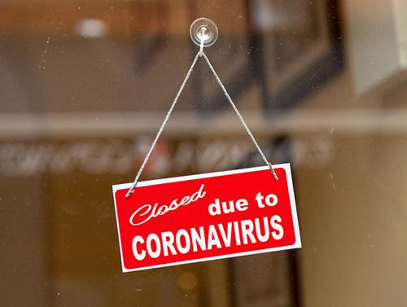
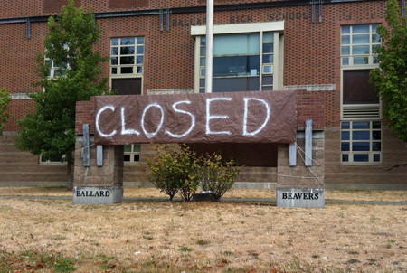
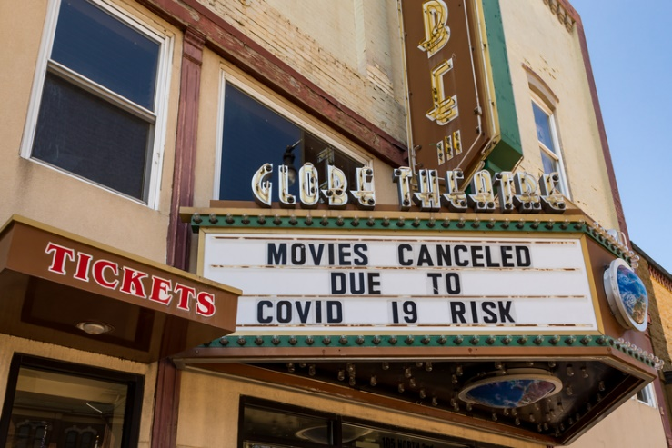
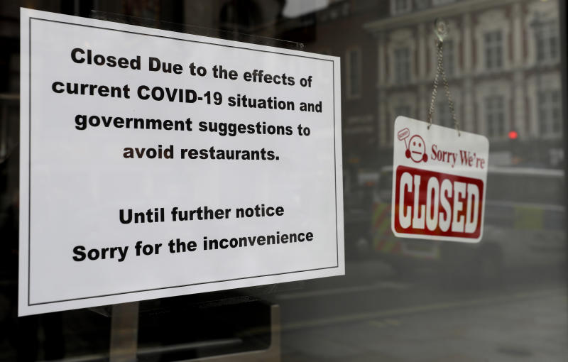
WHY?

Slide 4
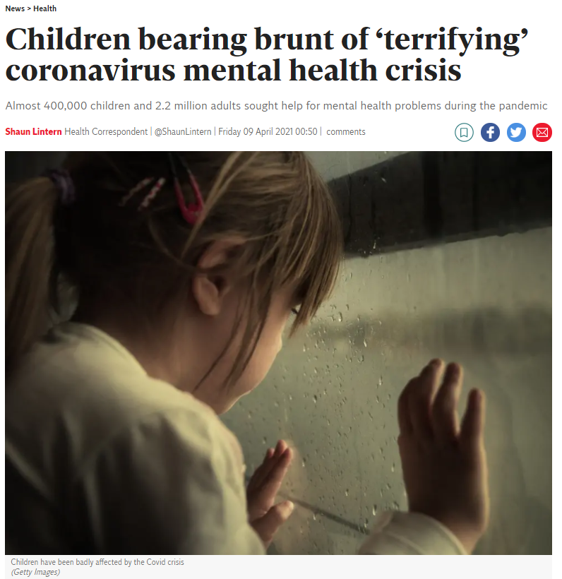
“Data shows that last year depression rates doubled and waiting times for mental health services, already poor before the pandemic, have rocketed – causing what has been termed ‘the mental health pandemic’. Those dealing with disasters will tell you, the aftermath is often worse than the explosion.” – Dr Joe McManners, General Practitioner and Oxford City Councilor

Slide 6
Case Study
Henry Pratt Shooting

Slide 7
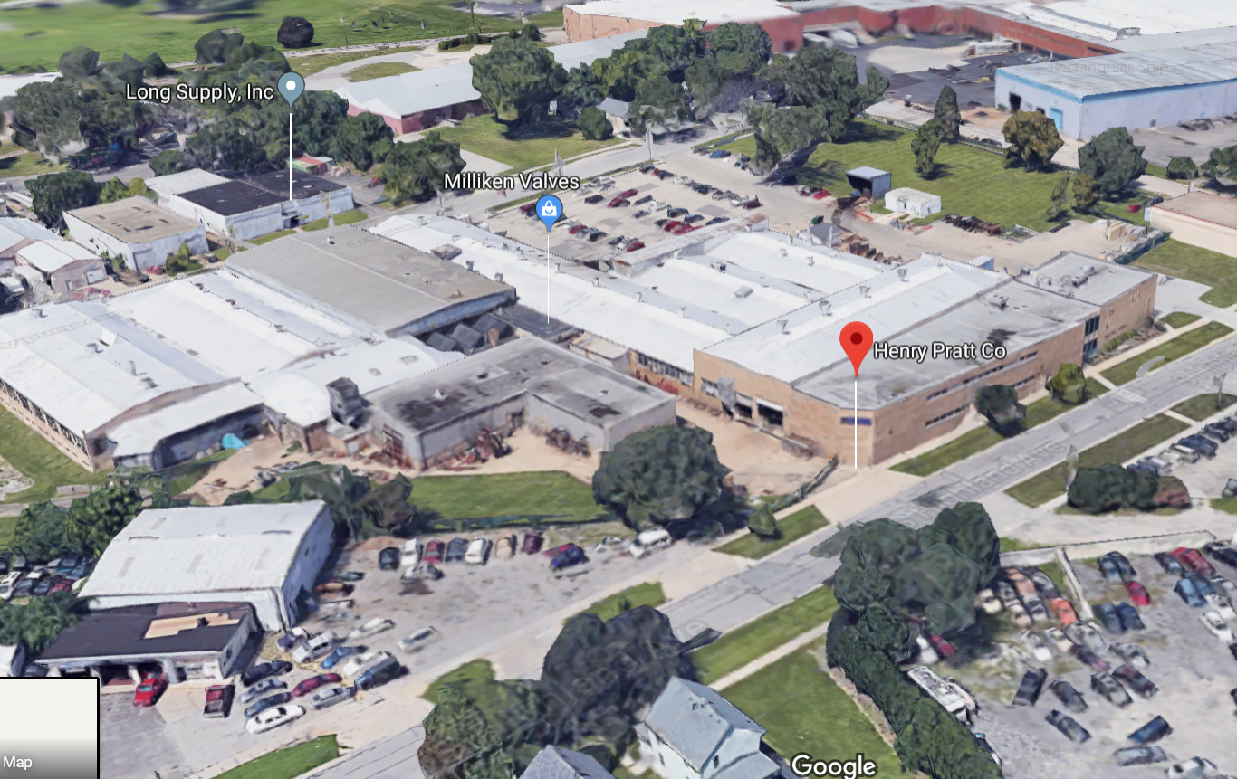
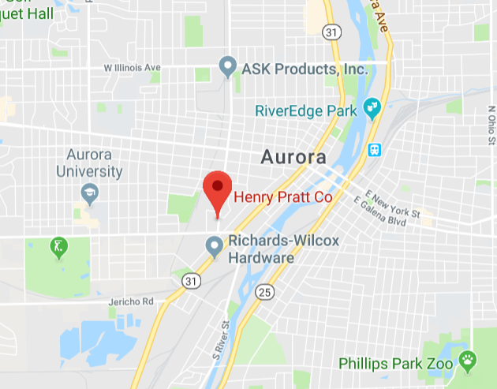
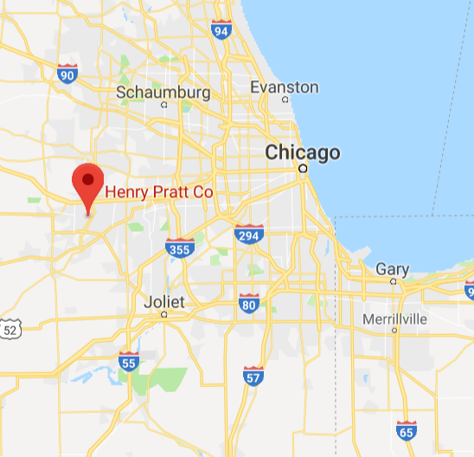
Henry Pratt Company – Founded 1901
Valve Manufacturing Warehouse
Aurora, IL (Chicagoland Area)
Access Card Readers
On-Site Security

Slide 8
Termination Hearing Details
Company has a progressive discipline process
Subject was summoned to the HR Office
Subject knew he was going through a discipline procedure for “various workplace rule violations”
Subject told his family he was “getting fired from his job” and was “very stressed”
CEO Stated, Subject was being terminated for a "culmination of violations of workplace rules“
Upon entering the HR Office, Subject pulled out a .40 Caliber pistol – shot a killed everyone in the office
Background check conducted 15 years ago, when Subject was hired
No evidence of a Threat Management Program within Pratt
“Getting fired from job…”

Slide 9
What Happened…
Subject was 20mins late to the termination meeting
In the Room:
HR Business Partner
HR Intern (First Day on Job)
2 Union Representatives
Policy Violation – Removed foam from safety googles because it was “uncomfortable”
Subject was belligerent and profane for most of the proceeding – sat with his back to his two union Reps
When told he was being terminated, Subject stated: “We are done here” and then began shooting
Killed HRBP, Intern and 1 Union Rep immediately
1 Union Rep shot in arm and then fled office, alerting others outside
Subject exited office and shot and killed two more employees outside HR Office
Found Union Rep he shot in arm, asked “Aren’t You Dead Yet,” then shoot him two more times in back

Slide 10
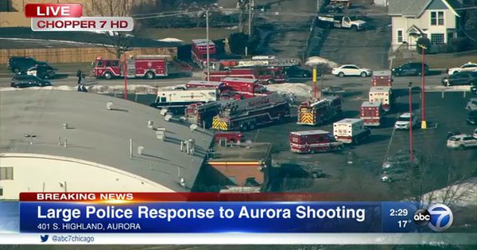
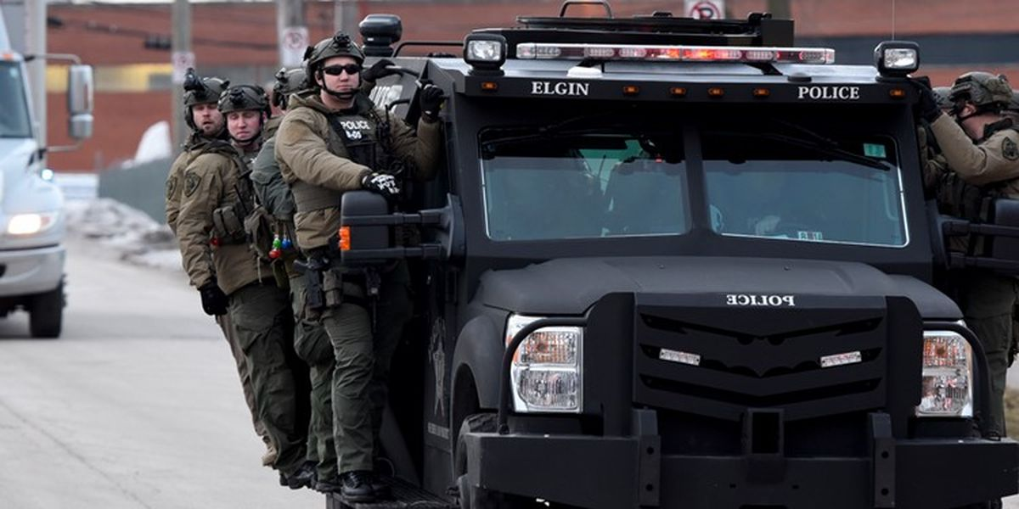
What Happened…
Police arrived on scene within 3 mins – engaged Subject
5 Officers shot/Injured
Subject hide in 29,000 sq. ft. warehouse – found 90mins later – killed by Officers in gun battle

Slide 12
Shooter
45 years old
Assemblyman with Pratt
15 year employee
Criminal History:
Arrested 6 times
Convicted felon – 1995 Mississippi Charge:
Domestic Violence
Aggravated battery for stabbing a woman (served 2.5 years).
2002 – Sued by his Landlord – Order of Protection Filed
Most recent arrest was in 2017 for Disorderly Conduct and Criminal Damage to Property
Multiple Moving Violation Charges
Never Should have owned a firearm

Slide 13
Problems
Hired and Background Check conducted in 2004
Most Background checks only go back 7 years
1995 arrest may not have been found in check
State of Mississippi failed to properly report arrest in Federal Background System
No additional Background checks conducted throughout employment
Employee never self-reported any arrests
No automated system in place to monitor court records
No known reports of concerning behavior to Management/HR/Security
No coordination with Security prior to termination

Slide 14
How Do We Prevent Something Similar?
Building a Program

Slide 15
Words Matter
Intervention
Workplace Violence Prevention Program
or
Threat Assessment and Management Program
C.A.R.E Team
(Campus Awareness Response Education)

Slide 16
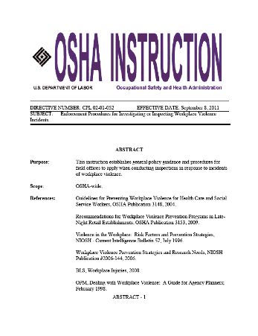
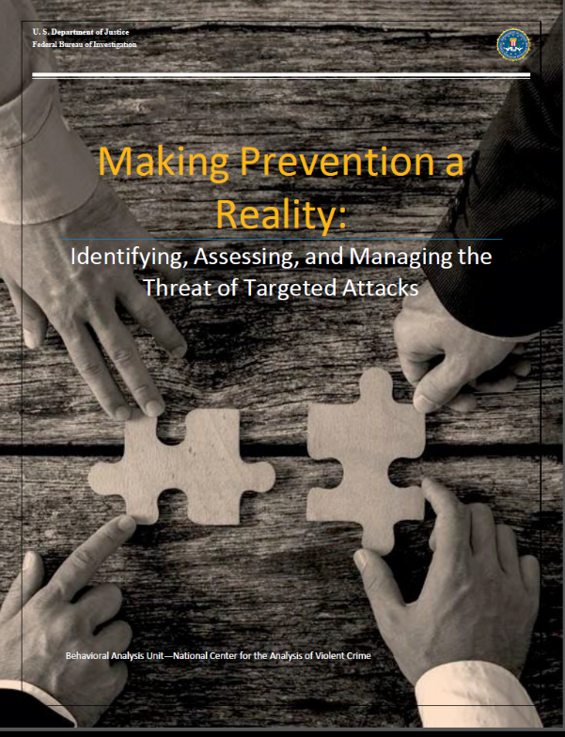
Resources

Slide 17
Domestic Violence Resource
VineLink (https://vinelink.vineapps.com/state)
Developed specifically for domestic violence victims
Notified when their abuser is released from jail
Captures all arrests, not just DV cases
FISWG/NCMS Fall Training Session

Slide 18
Association of Threat Assessment Professionals (ATAP)
Founded in 1992 by the Los Angeles Police Department Threat Management Unit (LAPD TMU)
Non-profit organization
14 Chapters Nationally
Membership of Approximately 2,500
Strict Eligibility Requirements
Diverse Membership:
Law Enforcement Officers
Prosecutors
Mental Health Professionals
Corporate Security Experts
Threat Management Team Members

Slide 19
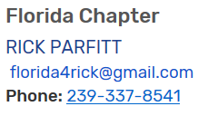
Association of Threat Assessment Professionals (ATAP)
Local chapters
Professional networking
Certification
Certified Threat Manager TM
Leadership opportunities
Local and Association Board of Directors
Recognition
Access to information
Members Only Website Access
Education
Seminars
Annual Conference
https://www.atapworldwide.org/

Slide 20
Back to the Basics
TAM 101

Slide 21
What is Workplace Violence?
Workplace Violence: “A spectrum of behaviors - including overt acts of violence, threats, and other conduct - that generates a reasonable concern for safety from violence, where a nexus exists between the behavior and the physical safety of employees and others (such as customer, clients, and business associates) on-site, or off-site, when related to the organization.”
Source: American National Standard on Workplace Violence Prevention and Intervention, ASIS/SHRM WVPI.1-2011, Definitions: Paragraph 3.16
A Spectrum of
Behaviors

Slide 22
Program Pillars
Prevention
Policy and Procedures
Education and Awareness
Threat Management Teams
Response
Threat Management Teams
Law Enforcement Engagement
Active Shooter Exercises
Continuous Improvement
Audit and Review
Professional Development
Safe and Secure Workplace

Slide 23
Policy and Procedure
Applicability
All employees, contractors, suppliers, customers, and visitors
Scope
Workplace: any place where employees perform work on behalf of company
Off premise situations with a relationship to the workplace, or affect the workplace
Define Zero Tolerance
Define Prohibited Conduct: “to include, but not limited to…”
Reporting Expectations
Call out Leaders and Managers
Responsibilities
Define Threat Management Team Process
Comprehensive
Policy

Slide 24
Education and Awareness
New Employee Orientation
New Leader Training
Annual Employee Training
General Awareness
Active Shooter Response Training
Specialty Training
Local Law Enforcement Speakers
Vendors – Consultants
ATAP / ASIS / FISWG
Threat Management Team Advanced Training
Cornerstone of
Your Program

Slide 25
Threat Management Teams
Core Team Structure
Security (Threat Manager) – Chair
Human Resources
Legal
Medical
As needed,
Management
Site Leadership
Ethics
EAP
Consultant
360 View

Slide 26
Threat Management Team Process
Process:
Concerning behavior is reported
Threat Management conducts a triage (Risk Assessment Tool)
If appropriate, the TMT is convened
Offsite Support Team and Subjects supervisor are included
TMT Actions:
Determine what immediate action, if any, is required
Violent Act
Suicidal Ideations – Behaviors of Concern
Not a Discipline Committee
Provide consultation to management
Oversee and review investigative process – Do not conduct the investigation
Develop Long-term Threat Mitigation strategy
FISWG/NCMS Fall Training Session

Slide 27
Threat Mitigation
Florida Baker Act Assessment – LEO or Medical Assessment
Professional Judgement Tools vs. Actuarial Tool
Professional Consultants
HR/Management Routine Follow-up/Monitoring
Soft Landings
Employee Confidant
Employee Assistance Programs (EAP)
Fitness for Duty Assessment – Medical Assessment
OSINT/Social Media Monitoring – Leakage
Public Records Automated Monitoring Solutions
FISWG/NCMS Fall Training Session

Slide 28
Professional Judgement Assessment Tools
Example Questions:
Known Grievance
Preoccupation with Violent Themes
Known Threats to Workplace or Co-Workers
Military Experience/Weapons Familiarity
Signs of Preparations for Violence (Final Act Behaviors)
Ask about POSITIVE Stressors, too!
Family, Faith, Community, etc.
Collect The Dots
To Connect The Dots
FISWG/NCMS Fall Training Session

Slide 29
Suspension, Termination, Evaluation Program (STEP) TM
Initiated when an employee is facing negative job action:
Disciplinary Committee
Administrative Action (MSS/PIP)
Process:
HRBP Submits Request to Committee POC
Committee POC sends STEP Intake Form to Threat Management
Threat Management Conducts the Assessment

Slide 30
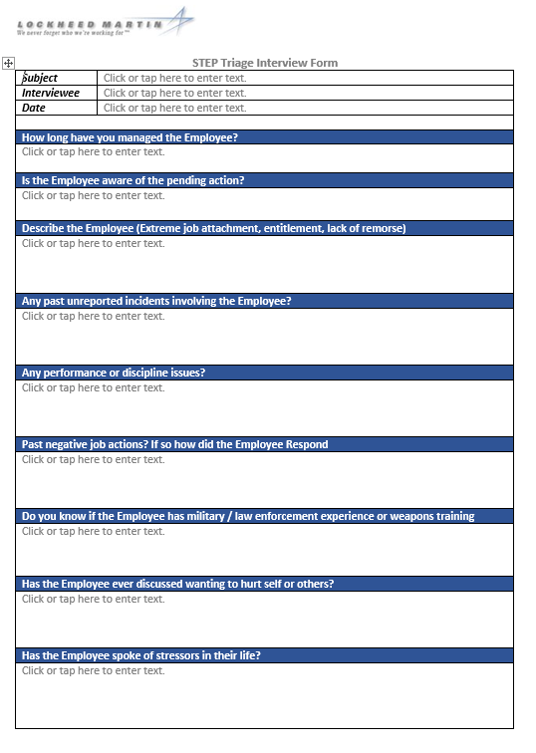
Threat Manager Process
Process:
STEP Intake Received
Pre-Committee:
360⁰ assessment w/ HRBP and Mgt
HRBP / Mgt monitors the subject while awaiting decision
Post Committee:
Coordinate employee notification
Proper Security
Proper Location
Proper Coordination

Slide 31
Program Pillars
Prevention
Policy and Procedures
Education and Awareness
Threat Management Teams
Response
Threat Management Teams
Law Enforcement Engagement
Active Shooter Exercises
Continuous Improvement
Audit and Review
Professional Development
Safe and Secure Workplace

Slide 32
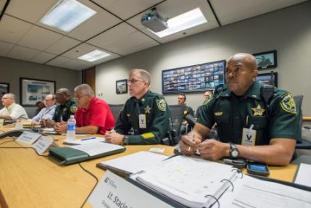
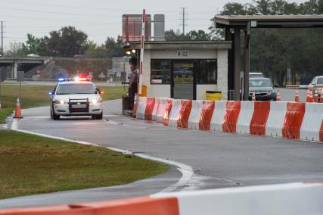
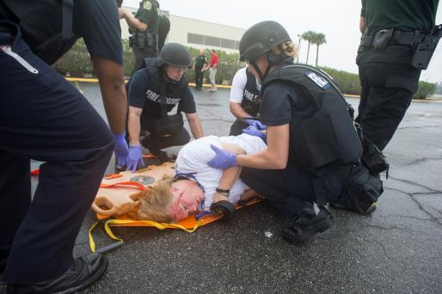
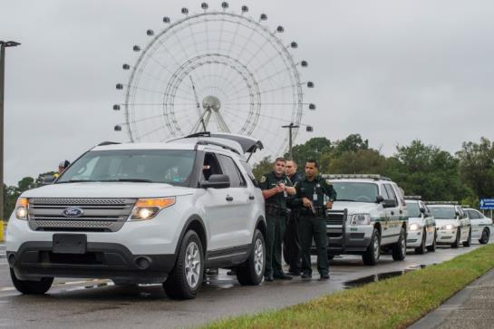
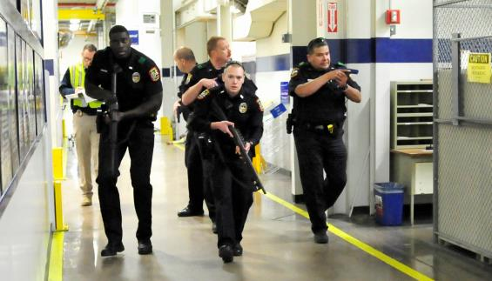
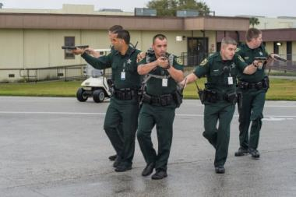
Active Shooter Preparedness and Response

Slide 33
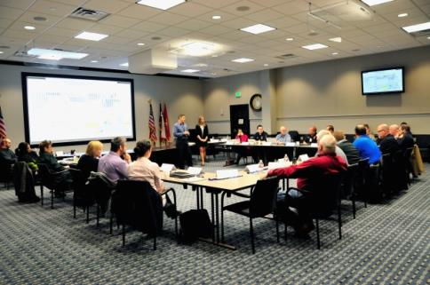
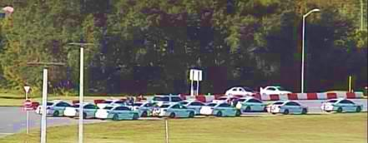
How to Get There?
Law Enforcement Coordination
Liaison and Networking
Familiarization Programs
Executive Buy-in
Active Shooter Table Top Exercises (TTX)
Have the right people at the table
Business Continuity
Active Shooter Full-Scale Exercises (FSE)
Planning, planning, planning
Keep it realistic
Focus on improving and understanding the response concept, identify opportunities and challenges and develop solutions

Slide 34
Program Pillars
Prevention
Policy and Procedures
Education and Awareness
Threat Management Teams
Response
Threat Management Teams
Law Enforcement Engagement
Active Shooter Exercises
Continuous Improvement
Audit and Review
Professional Development
Safe and Secure Workplace

Slide 35
Continuous Improvement
Audit and Review Your Program at least Annually
Consultants
Internal Audit
Self-Inspection
Professional Development
Professional Associations – ATAP
ASIS Global Security Conference (GSC)
Professional Training
FISWG/NCMS Fall Training Session

Slide 36
ITPSO Correlation
Insider Threat Definition:
The threat presented by a person who has or once had authorized access to information, facilities, networks, people, or resources and who wittingly or unwittingly committed: acts in contravention of law or policy that resulted in or might result in harm through the loss or degradation of government or company information, resources or capabilities; or destructive acts to include physical harm to others in the workplace.
- Intelligence and National Security Alliance (INSA)
FISWG/NCMS Fall Training Session

Slide 37
Questions?
FISWG/NCMS Fall Training Session

